Slide 1

TYPESCRIPT BASICS FOR AZLE CANISTER DEVELOPMENT
This presentation provides an overview of Typescript basics for Azle Canister development. It covers topics such as; What are Canisters and Azle in the Internet Computer ecosystem, Why Typescript and the it’s basics, setting up for Azle development among many others!!
LET’S GET STARTED 🚀

Slide 2
Session Objectives
What are Canisters in Azle development
Understand Essential TS for Azle Canister Development
Environment set-up for Azle development
What next?

Slide 3
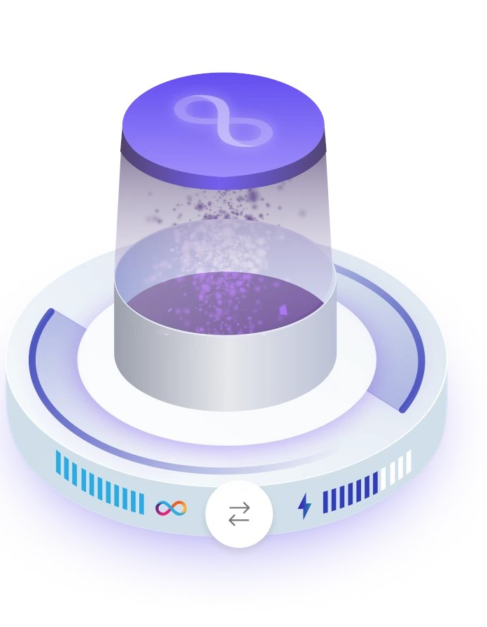
Azle & Canisters
📕 Azle is a Typescript and JavaScript CDK(Canister Development Kit), i.e., it’s a runtime for building applications(canisters) on the Internet Computer. Learn More💡
🥫 Canisters: Theses are just computational “units” containing your program code to be executed on the IC chain. Learn More💡

Slide 4
Basic Typescript for Azle Development
This TS & JS datatype is decoded to text in Candid
TS/JS arrays are decoded to vec type while objects to Record type
Used as bool as a Candid type
string
number
boolean
float
Array & Object
Decoded to Candid type int8
Decoded to either float32 or float64 in Candid

Slide 5
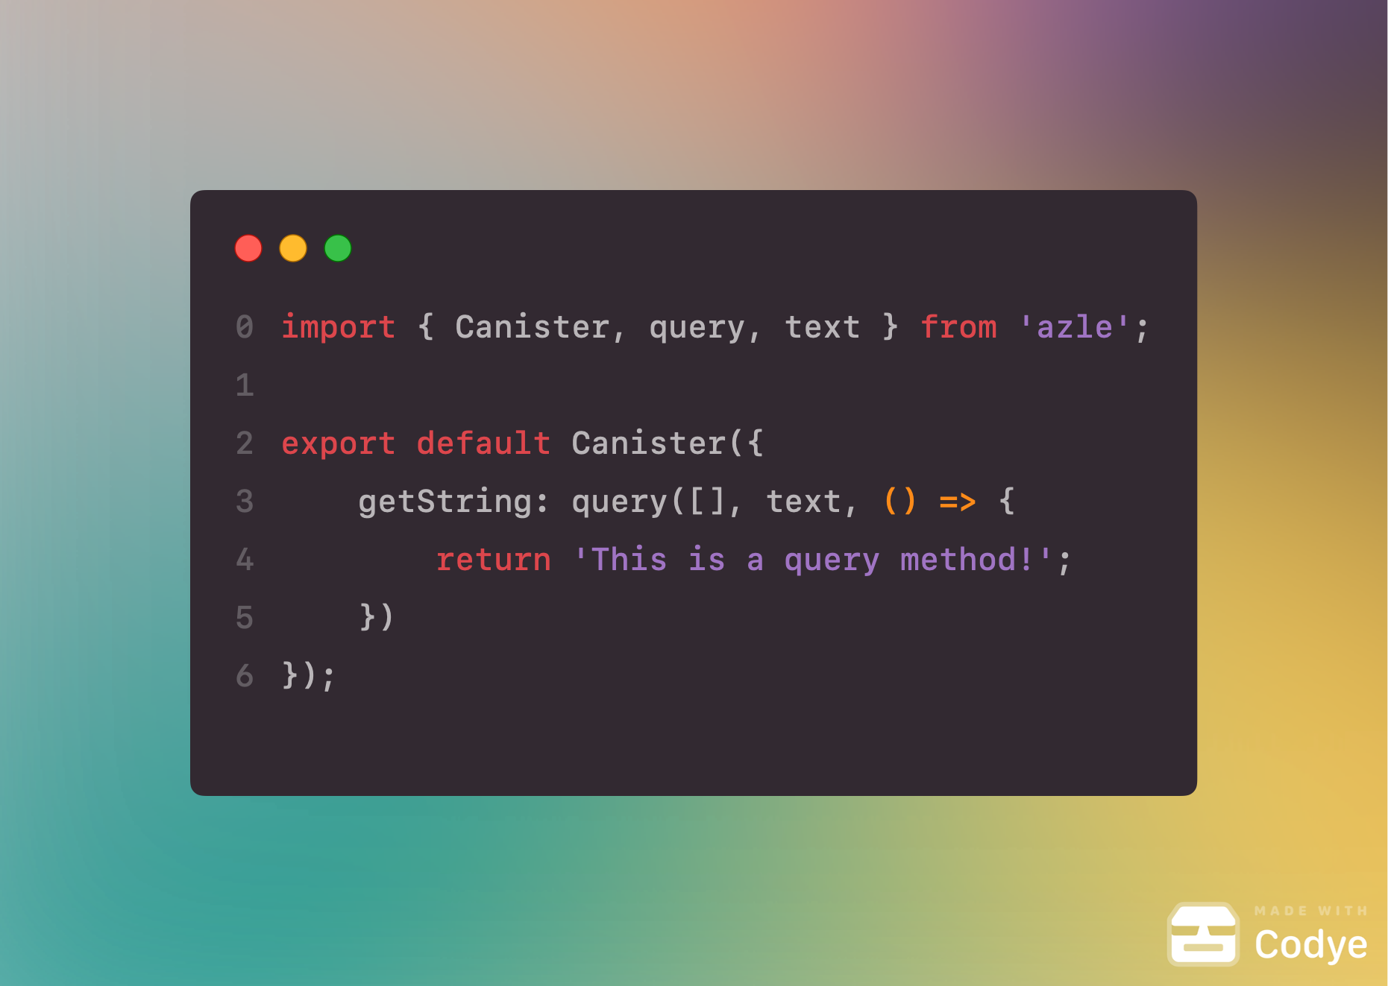
Query Method
In Azle, Query methods, also functions are created using the query keyword. Query methods are used to expose a canister’s functionalities.
Learn More💡
The first parameter describes the Candidtypes used for argument in your query method.
The second is a CandidType object used to encode the return value of your function to
The third parameter to query is the function that receives the decoded arguments, performs some computation, and then returns a value to be encoded.

Slide 6
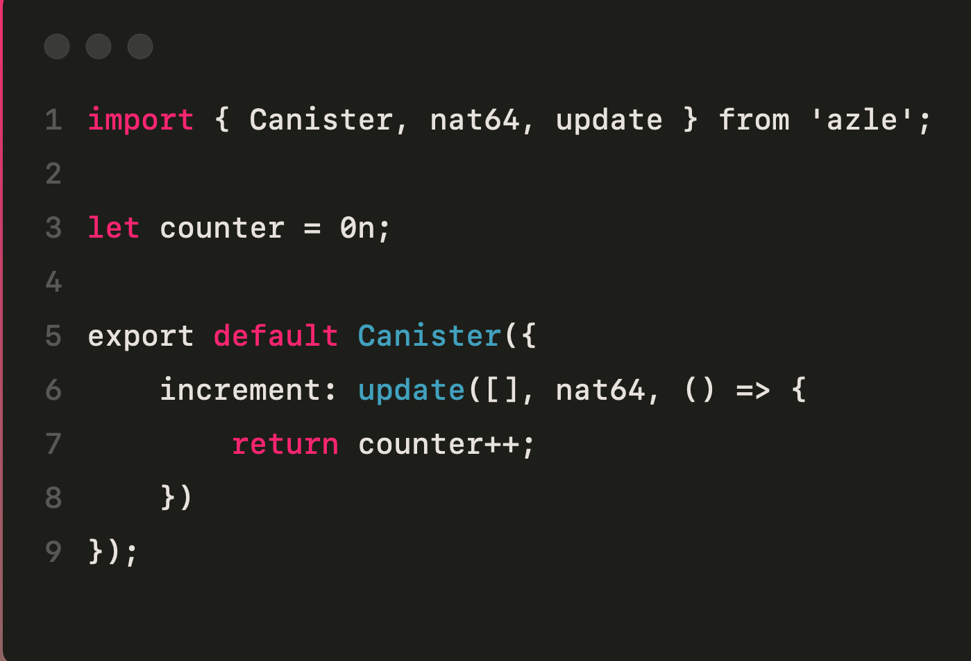
Update Method
Update methods, also functions are like query methods, but they enable state changes to be persisted. The syntax is basically the same the following code shows an example.
The method defined above when called will return and increment the value of counter which is a global variable. Thus, any subsequent query method will have access to an update counter variable.

Slide 7
Basic Typescript for Azle Development
Simple db program
Exercise
What is Candid UI?

Slide 8
Summary & QA
Questions?
What are the Key Takeaways?
Learning Resources

Slide 9
Thank you for your time and attention 🙂

